Slide 1
Stacks
© 2010 Goodrich, Tamassia
Stacks

Slide 2
Abstract Data Types (ADTs)
An abstract data type (ADT) is an abstraction of a data structure
An ADT specifies:
  Data stored
  Operations on the data
  Error conditions associated with operations
Example: ADT modeling a simple stock trading system
  The data stored are buy/sell orders
  The operations supported are
    order buy(stock, shares, price)
    order sell(stock, shares, price)
    void cancel(order)
  Error conditions:
    Buy/sell a nonexistent stock
    Cancel a nonexistent order
© 2010 Goodrich, Tamassia
Stacks

Slide 3

The Stack ADT
The Stack ADT stores arbitrary objects
Insertions and deletions follow the last-in first-out scheme
Think of a spring-loaded plate dispenser
Main stack operations:
  push(object): inserts an element
  object pop(): removes the last inserted element
Auxiliary stack operations:
  object top(): returns the last inserted element without removing it
  integer size(): returns the number of elements stored
  boolean empty(): indicates whether no elements are stored
© 2010 Goodrich, Tamassia
Stacks

Slide 4
Stack Interface in C++
template <typename E>
class Stack {
public:
int size() const;
bool empty() const;
const E& top() const
throw(StackEmpty);
void push(const E& e);
void pop() throw(StackEmpty);
}
C++ interface corresponding to our Stack ADT
Uses an exception class StackEmpty
Different from the built-in C++ STL class stack
© 2010 Goodrich, Tamassia
Stacks

Slide 5
Exceptions
Attempting the execution of an operation of ADT may sometimes cause an error condition, called an exception
Exceptions are said to be “thrown” by an operation that cannot be executed
In the Stack ADT, operations pop and top cannot be performed if the stack is empty
Attempting pop or top on an empty stack throws a StackEmpty exception
© 2010 Goodrich, Tamassia
Stacks

Slide 6
Applications of Stacks
Direct applications
  Page-visited history in a Web browser
  Undo sequence in a text editor
  Chain of method calls in the C++ run-time system
Indirect applications
  Auxiliary data structure for algorithms
  Component of other data structures
© 2010 Goodrich, Tamassia
Stacks

Slide 7
C++ Run-Time Stack
The C++ run-time system keeps track of the chain of active functions with a stack
When a function is called, the system pushes on the stack a frame containing
  Local variables and return value
  Program counter, keeping track of the statement being executed
When the function ends, its frame is popped from the stack and control is passed to the function on top of the stack
Allows for recursion
main() {
int i = 5;
foo(i);
}
foo(int j) {
int k;
k = j+1;
bar(k);
}
bar(int m) {
…
}
bar
PC = 1
m = 6
foo
PC = 3
j = 5
k = 6
main
PC = 2
i = 5
© 2010 Goodrich, Tamassia
Stacks

Slide 8
Array-based Stack
A simple way of implementing the Stack ADT uses an array
We add elements from left to right
A variable keeps track of the index of the top element
Algorithm size()
return t + 1
Algorithm pop()
if empty() then
throw StackEmpty
else
t ← t − 1
return S[t + 1]
…
S
0
1
2
t
© 2010 Goodrich, Tamassia
Stacks

Slide 9
Array-based Stack (cont.)
The array storing the stack elements may become full
A push operation will then throw a StackFull exception
  Limitation of the array-based implementation
  Not intrinsic to the Stack ADT
Algorithm push(o)
if t = S.size() − 1 then
throw StackFull
else
t ← t + 1
S[t] ← o
…
S
0
1
2
t
© 2010 Goodrich, Tamassia
Stacks

Slide 10
Performance and Limitations
Performance
  Let n be the number of elements in the stack
  The space used is O(n)
  Each operation runs in time O(1)
Limitations
  The maximum size of the stack must be defined a priori and cannot be changed
  Trying to push a new element into a full stack causes an implementation-specific exception
© 2010 Goodrich, Tamassia
Stacks

Slide 11
Array-based Stack in C++
template <typename E>
class ArrayStack {
private:
E* S; // array holding the stack
int cap; // capacity
int t; // index of top element
public:
// constructor given capacity
ArrayStack( int c) :
S(new E[c]), cap(c), t(-1) { }
void pop() {
if (empty()) throw StackEmpty
(“Pop from empty stack”);
t--;
}
void push(const E& e) {
if (size() == cap) throw
StackFull(“Push to full stack”);
S[++ t] = e;
}
… (other methods of Stack interface)
© 2010 Goodrich, Tamassia
Stacks

Slide 12
Example use in C++
* indicates top
ArrayStack<int> A; // A = [ ], size = 0
A.push(7); // A = [7*], size = 1
A.push(13); // A = [7, 13*], size = 2
cout << A.top() << endl; A.pop(); // A = [7*], outputs: 13
A.push(9); // A = [7, 9*], size = 2
cout << A.top() << endl; // A = [7, 9*], outputs: 9
cout << A.top() << endl; A.pop(); // A = [7*], outputs: 9
ArrayStack<string> B(10); // B = [ ], size = 0
B.push("Bob"); // B = [Bob*], size = 1
B.push("Alice"); // B = [Bob, Alice*], size = 2
cout << B.top() << endl; B.pop(); // B = [Bob*], outputs: Alice
B.push("Eve"); // B = [Bob, Eve*], size = 2
© 2010 Goodrich, Tamassia
Stacks

Slide 13
Parentheses Matching
Each “(”, “{”, or “[” must be paired with a matching “)”, “}”, or “[”
  correct: ( )(( )){([( )])}
  correct: ((( )(( )){([( )])}
  incorrect: )(( )){([( )])}
  incorrect: ({[ ])}
  incorrect: (
© 2010 Goodrich, Tamassia
Stacks

Slide 14
Parentheses Matching Algorithm
Algorithm ParenMatch(X,n):
Input: An array X of n tokens, each of which is either a grouping symbol, a
variable, an arithmetic operator, or a number
Output: true if and only if all the grouping symbols in X match
Let S be an empty stack
for i=0 to n-1 do
if X[i] is an opening grouping symbol then
S.push(X[i])
else if X[i] is a closing grouping symbol then
if S.empty() then
return false {nothing to match with}
if S.pop() does not match the type of X[i] then
return false {wrong type}
if S.empty() then
return true {every symbol matched}
else return false {some symbols were never matched}
© 2010 Goodrich, Tamassia
Stacks

Slide 15
Evaluating Arithmetic
Expressions
Slide by Matt Stallmann included with permission.
14 – 3 * 2 + 7 = (14 – (3 * 2) ) + 7
Operator precedence
* has precedence over +/–
Associativity
operators of the same precedence group
evaluated from left to right
Example: (x – y) + z rather than x – (y + z)
Idea: push each operator on the stack, but first pop and perform higher and equal precedence operations.
© 2010 Stallmann
Stacks

Slide 16
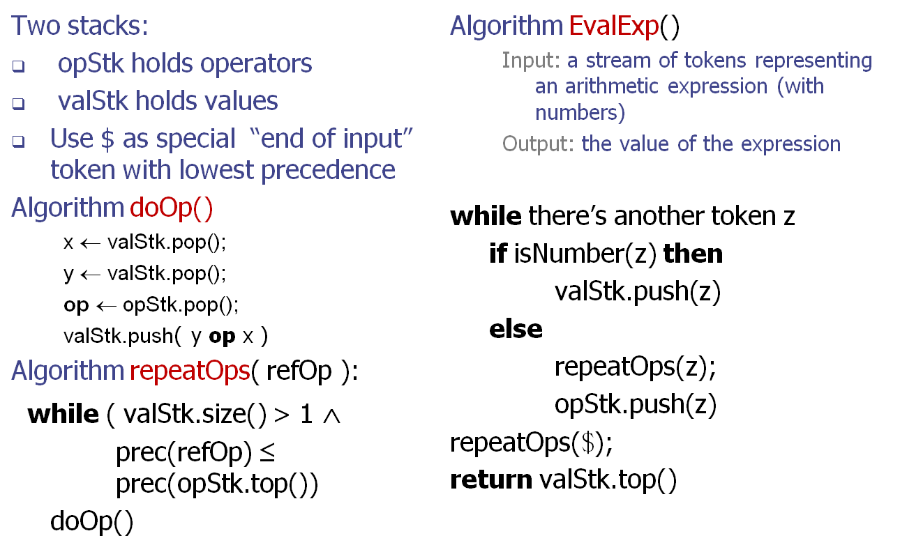
Algorithm for
Evaluating Expressions
Slide by Matt Stallmann included with permission.
© 2010 Stallmann
Stacks

Slide 17
Algorithm on an
Example Expression
Slide by Matt Stallmann included with permission.
Operator ≤ has lower precedence than +/–
14 ≤ 4 – 3 * 2 + 7
4
–
14
≤
3
*
$
$
4
–
7
$
14
≤
F
+
-2
+
5
+
14
≤
14
≤
2
2
3
*
3
*
6
4
–
4
–
4
–
-2
+
14
≤
14
≤
14
≤
14
≤
© 2010 Stallmann
Stacks

Slide 18
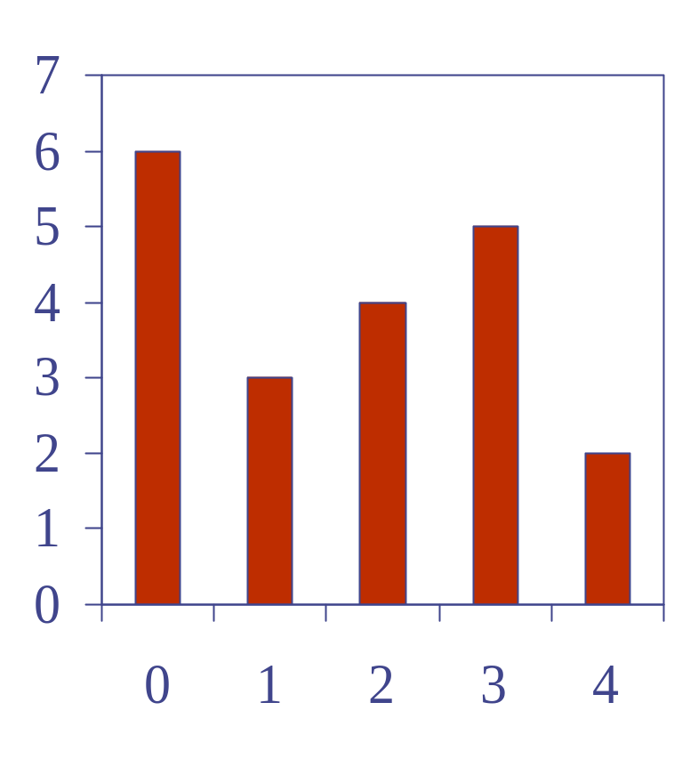
Computing Spans (not in book)
Using a stack as an auxiliary data structure in an algorithm
Given an an array X, the span S[i] of X[i] is the maximum number of consecutive elements X[j] immediately preceding X[i] and such that X[j] ≤ X[i]
Spans have applications to financial analysis
  E.g., stock at 52-week high
X
6 | 3 | 4 | 5 | 2
1 | 1 | 2 | 3 | 1
S
© 2010 Goodrich, Tamassia
Stacks

Slide 19
Quadratic Algorithm
Algorithm spans1(X, n)
Input array X of n integers
Output array S of spans of X #
S ← new array of n integers n
for i ← 0 to n − 1 do n
s ← 1 n
while s ≤ i ∧ X[i − s] ≤ X[i] 1 + 2 + …+ (n − 1)
s ← s + 1 1 + 2 + …+ (n − 1)
S[i] ← s n
return S 1
Algorithm spans1 runs in O(n²) time
© 2010 Goodrich, Tamassia
Stacks

Slide 20
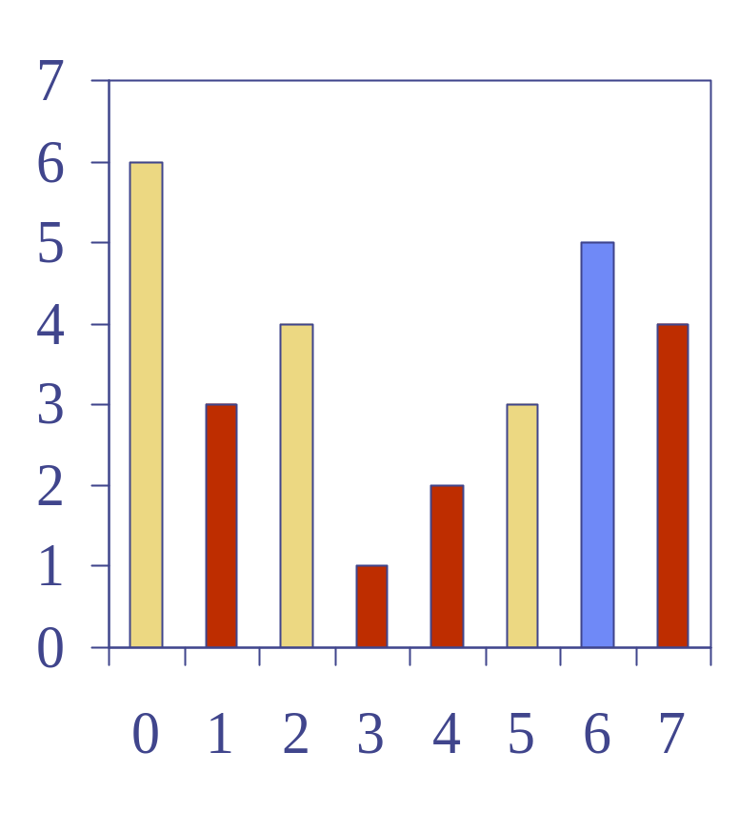
Computing Spans with a Stack
We keep in a stack the indices of the elements visible when “looking back”
We scan the array from left to right
  Let i be the current index
  We pop indices from the stack until we find index j such that X[i] < X[j]
  We set S[i] ← i − j
  We push x onto the stack
© 2010 Goodrich, Tamassia
Stacks

Slide 21
Linear Algorithm
Each index of the array
  Is pushed into the stack exactly one
  Is popped from the stack at most once
The statements in the while-loop are executed at most n times
Algorithm spans2 runs in O(n) time
Algorithm spans2(X, n) #
S ← new array of n integers n
A ← new empty stack 1
for i ← 0 to n − 1 do n
while (¬A.empty() ∧
X[A.top()] ≤ X[i] ) do n
A.pop() n
if A.empty() then n
S[i] ← i + 1 n
else
S[i] ← i − A.top() n
A.push(i) n
return S 1
© 2010 Goodrich, Tamassia
Stacks

